Slide 1

Utilisation trends of General Practices Surgeries
Fernanda Kyle
Data Analyst
Notes:
My name is Fernanda Kyle, I’m going to present the data I’ve analised on the Utilisation trends of GPSurgeries

Slide 2
Objective
NHS faces challenges in accommodating its growing population; effective resource allocation is crucial.
Understanding utilisation trends within the NHS network is essential for budget planning.
Analysed historical appointment data from NHS England for General Practice Surgeries.
Notes:
The reason you are here is because

Slide 3
Key Questions for Budget Planning
Capacity Assessment:
How does current utilisation compare to the available capacity within the NHS network?
Are there specific areas within the network experiencing overutilisation or underutilisation?
Utilisation Trends:
How do utilisation trends vary across different components of the NHS network?
Are there any seasonal or temporal patterns in utilisation?
Missed Appointments:
What is the rate of missed appointments across different NHS services?
External Data Integration:
Is there a potential value of incorporating external data sources such as Twitter?
Notes:
And I’m going to address these key questions for budget planning.
We are going to look at Capacity Assessment:
We aim to gain a comprehensive understanding of current utilization patterns, identify areas for optimization, and explore the potential benefits of incorporating external data sources such as Twitter.

Slide 4

Capacity Assessment Utilisation of resources Missed Appointments External Data Integration
Notes:
Lets start looking at capacity assessment results

Slide 5
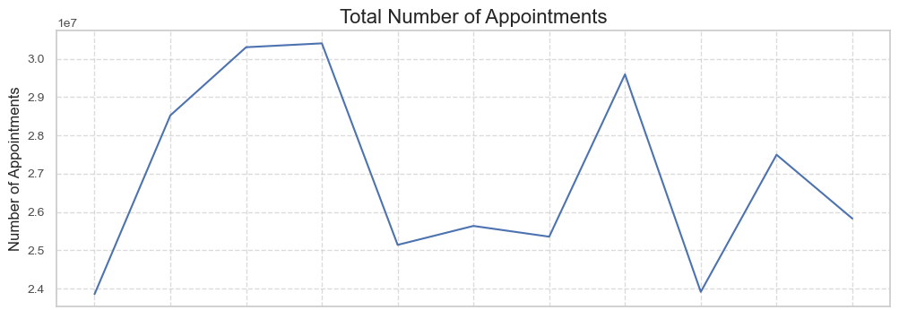
Number of appointments over time
296,046,770 appointments
Notes:
This graph shows the total number of appointment over the period analysed, from August 21 to June 22. The background highlight the seasons and it’s surprising that Winter has actually a smaller demand than Autum
I want to bring you the stunning figure that over this period there was almost 300 million appointments booked on GP Surgeries.
Now we are going the unravel the details behind this figure

Slide 6
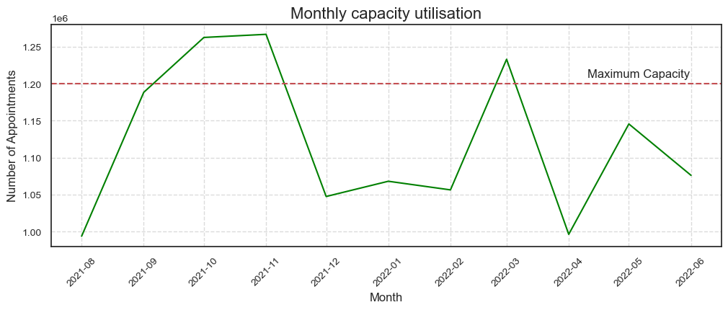
Capacity Utilisation
Flexible staffing to cope with variation
Limitations:
Maximum capacity of GPs and Nurses.
Type of appointments.
Staff and Infrastructure.
Regional demographics or healthcare needs.
Notes:
NHS sets its capacity at 1.2 million appointments per day over the whole network. It’s below maximum capacity for most of the time, however it exceeds by around 5% on peak period.
However there are several limitations to this study, as the lack to granularity for Maximum capacity of GPs and Nurses and Type of appointments.
We are also missing on staff and infrastructure data as well as regional demographics or healthcare needs.

Slide 7
Capacity Assessment Utilisation of resources Missed Appointments External Data Integration
Notes:
Lets start looking at capacity assessment results

Slide 8
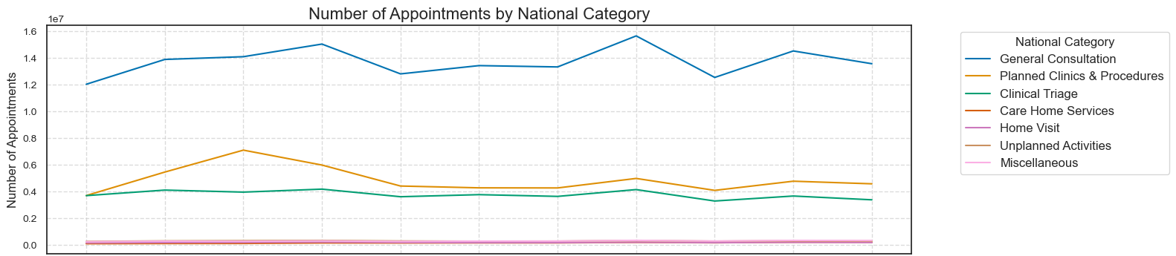
Appointment categories
Notes:
The appointments can be divided in several categories
We can see that “General-Consultation” was the most frequent category, throughout the year.
However I’d like to draw your attention to this peak in October of planned clinics and procedures, and notice that this peak happens independent from the general consultation, that remains flat.
This is different from this other peak in March.
I explored the increase on the planned clinics in October

Slide 9
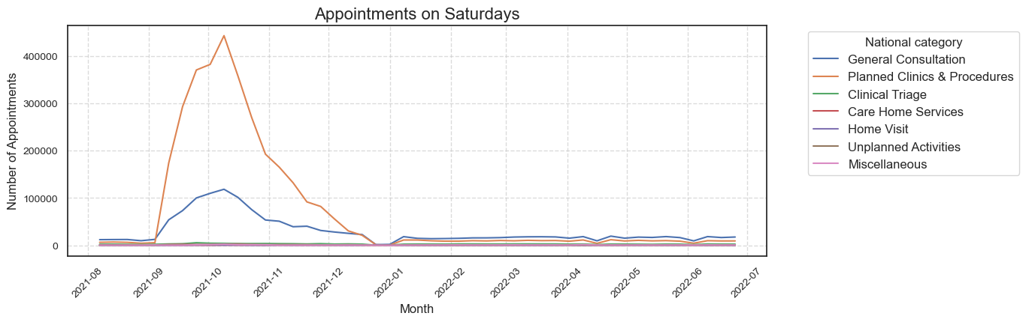
Increase on Planned Clinics during Autumn is due to Saturday clinics nationwide
Limitation: Costs associated?
Notes:
I discovered that it happened due Saturdays planned clinics that happened on Saturdays throughout the country

Slide 10
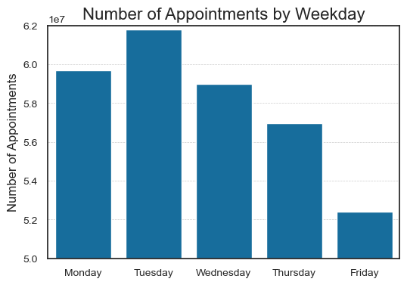
Fridays had nearly 10 million fewer appointments than Tuesdays
Notes:
Regarding days of the week, I discovered that appointments happen more at the beginning of the week, with Friday having almost 10 million fewer appointments than Tuesdays

Slide 11
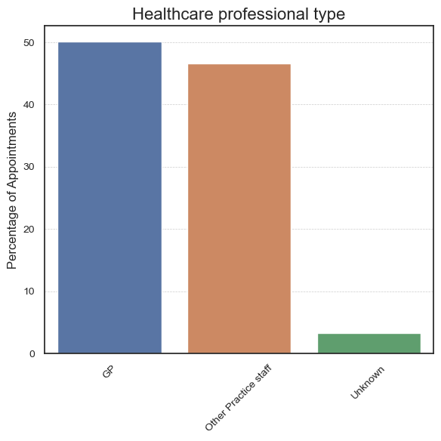
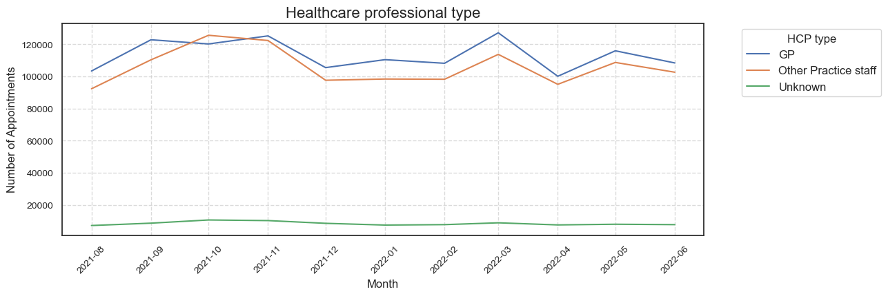
Healthcare professional type
Other practice staff:
Acupuncturist
Chiropodist
Community Psychiatric Nurse
Counsellor
Dispenser
District Nurse
Health Visitor
Interpreter/Link Worker
Osteopath
Other Practice Staff
Physiotherapist
Practice Nurse
Need to discern between different professionals for improved planning.
Notes:
GPs account for 53.5% of the total appointments, while Other Practice Staff represent 46.5%.
Other-Practice-Staff comprises range of 12 professional types, including nurses.
I believe it’s crucial to discern between different professionals for improved planning.

Slide 12
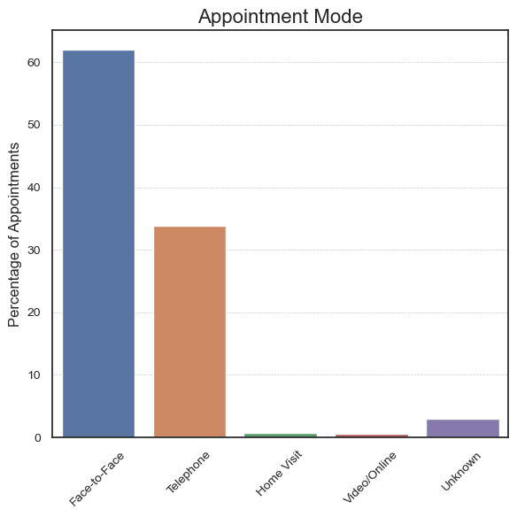
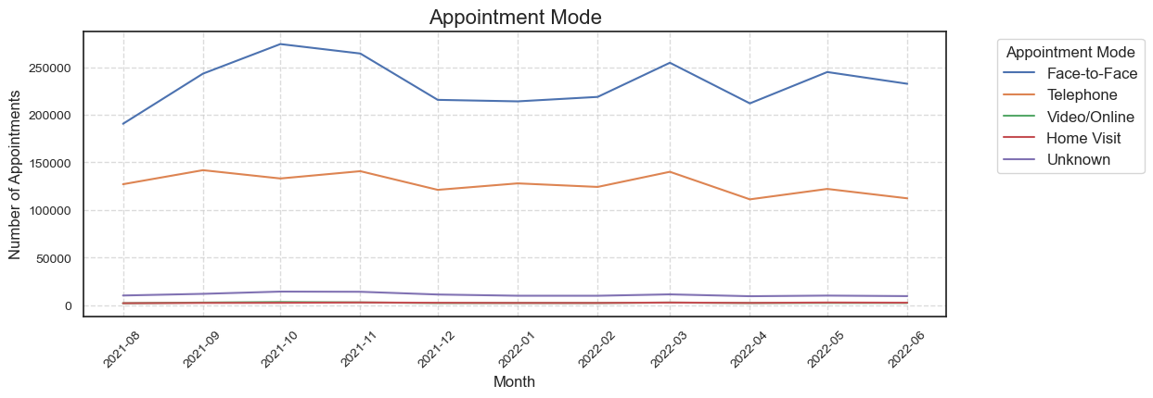
Appointment Mode
During periods of increased demand, patients tend to prefer or require face-to-face appointments.
Notes:
Face-to-face appointments represent the majority of appointments (61%), while telephone appointments make up a significant portion as well (38%).
This suggests that during periods of increased demand, patients tend to prefer or require face-to-face appointments.

Slide 13
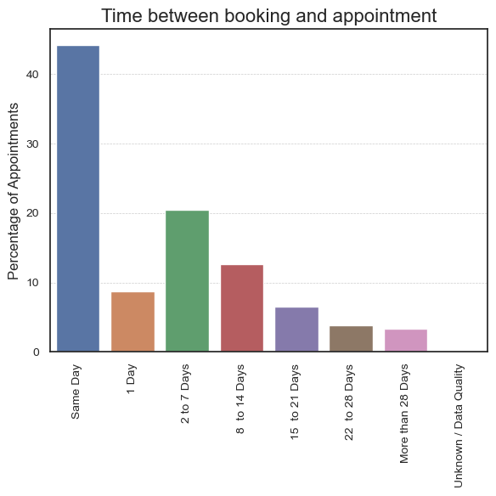
Time between booking and appointment
A significant portion of patients prefer or require short notice appointments.
This might reflect the inability to book an appointment for the next day
Implementing a 1 day appointment system instead of 8 am call for same day appointment.
Notes:
The majority of appointments are booked for the same day (46%), suggesting that a significant portion of patients prefer or require short notice appointments.
However, the next most common timeframe is 2-7 days, rather than 1 day.

Slide 14
Capacity Assessment Utilisation of resources Missed Appointments External Data Integration

Slide 15
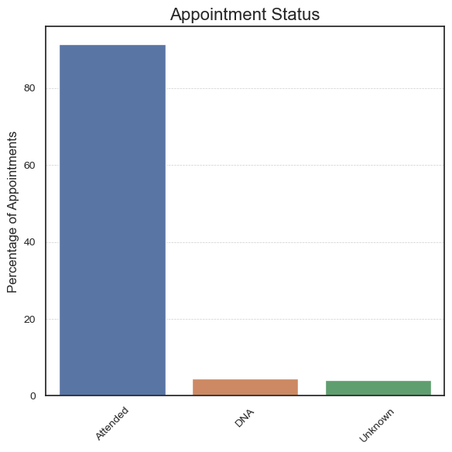
Appointment Status
The vast majority (95.4%) of appointments are attended.
13,318,384 missed appointments (4.6% )

Slide 16
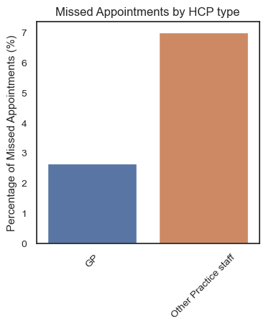
Missed Appointments by Healthcare Professional
Appointments with GPs are less likely to be missed compared to those with Other Practice Staff.
Recommendation:
Targeted reminders
Patient awareness campaign about the importance other staff than GP.
Staff Training and Support.
Notes:
specifically for appointments with Other Practice Staff,
, including effective communication techniques, building rapport with patients

Slide 17
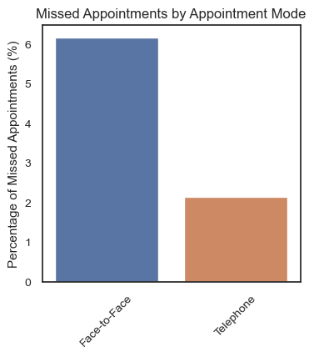
Missed Appointments by Appointment Mode
Face-to-face appointments are more likely to be missed than telephone appointments.
Recommendation:
Optimized scheduling to reduce wait times
Target reminder systems
Increase availability of telephone appointments as an alternative option, especially for follow-up visits.
Notes:
where in-person visits may not be necessary

Slide 18
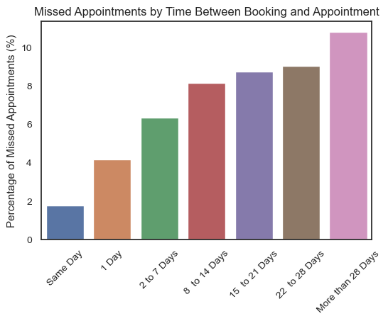
Missed Appointments by Time Between Booking and Appointment
Same-day appointments have the lowest percentage of missed appointments (1.7%), and the longer the time between booking and appointments, the higher the chances of the appointment being missed.
Recommendation:
Target reminder systems.

Slide 19
Recommendations

Slide 20
Recommendations
Capacity Assessment:
Gather data on staff, infrastructure, regional demographics or healthcare needs.
Utilisation Trends:
Planned clinics on Saturdays during Autumn can be expand for the whole year.
Increase appointments towards the end of the week for an optimised distribution.
Separate “Nurse” data from other practice staff for proper planning.
Plan to an increased face-to-face capacity during peak months.
Facilitate next-day booking, might improve patient and staff experience.
Missed Appointments:
Targeted reminders (non GP, face-to-face and long-term booking)
Patient awareness campaign.
Scheduling optimization .
Limitations: patient's demographic or socioeconomic factors
Notes:
to accommodate patients' diverse schedules and release pressure on GP same day appointments
Limitations to Missed appointments: We don't have any information regarding the patient's demographic or socioeconomic factors associated with higher rates of missed appointments.

Slide 21


Capacity Assessment Utilisation of resources Missed Appointments External Data Integration

Slide 22
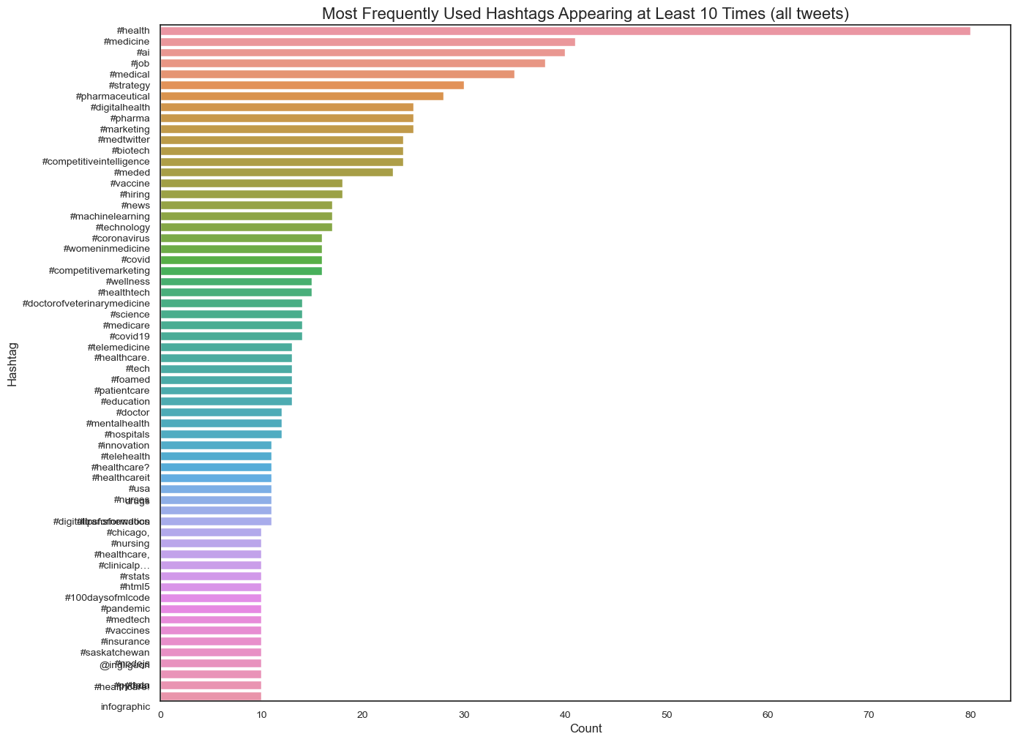
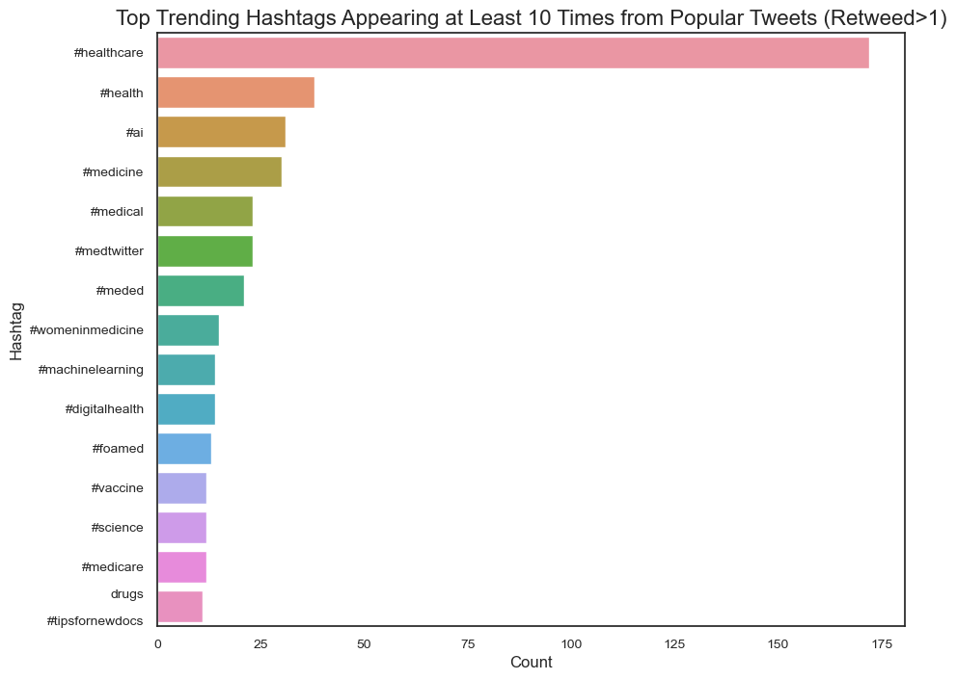
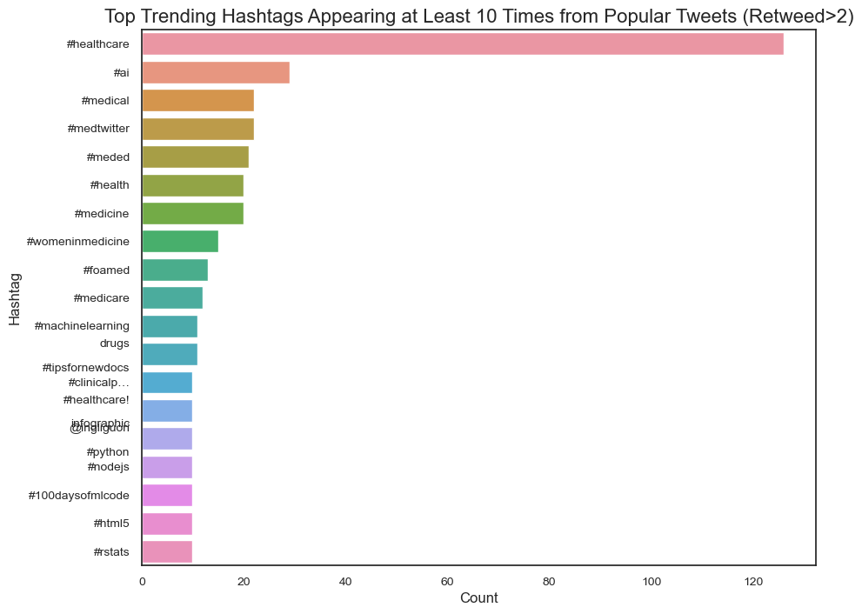
Most frequent tweets hashtags
Impact in promoting NHS hashtags
Notes:
We are looking at database that gathered Tweets in the UK with the hashtag Healthcare. The most frequently used reveals a broader conversation on Twitter.
We can see hashtags such as #strategy, #pharmal, #marketing, #Competitive Inteligence, #Competitive Marketing mixed with nhs relevant hashtags.
Indicates a diverse range of topics being discussed.
When we filtering for tweets with more than one retweet we have clearer visibility of important hashtags for the NHS, such as #digitalhealth, #vaccine, and #science, among the top trending hashtags
However, when we Filter for tweets with more than two retweets the hashtags highlighted that I just mentioned above no longer appear among the top trending hashtags.
This highlights the potential impact in promoting NHS hashtags.

Slide 23
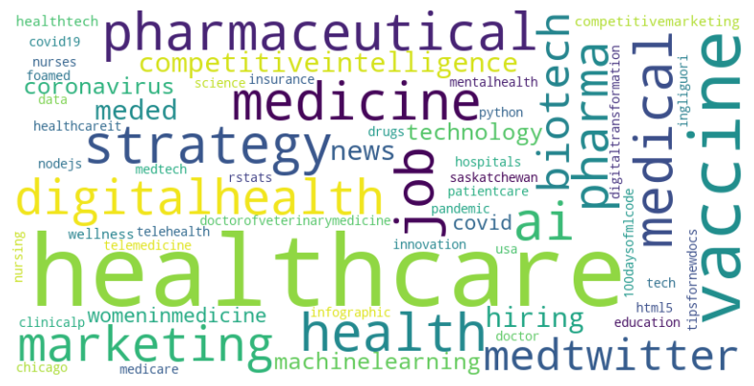
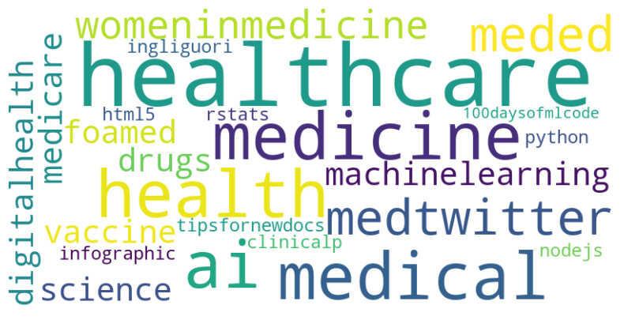
Example 1: Word Clouds
All tweets
Retweeted or favorited at least 1x
Notes:
There are many other ways to analyse social media data, for example, here we have Word clouds.
The size of each word corresponds to its frequency of appearance in the analyzed text data.

Slide 24
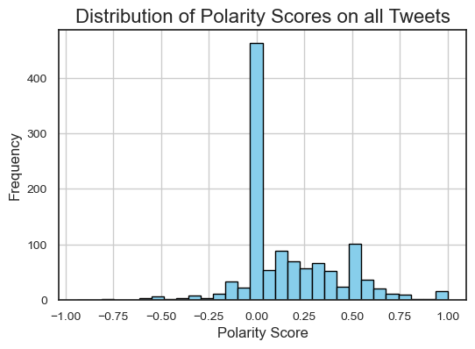
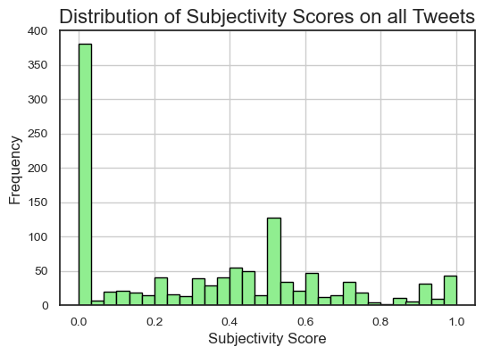
Example 2: Sentiment Analysis
Scores close to 1 indicate highly positive sentiment.
Scores close to -1 indicate highly negative sentiment.
Scores around 0 indicate neutral or mixed sentiment.
Scores close to 0 indicate the text is more objective (factual).
Scores close to 1 indicate the text is more subjective (opinionated).
Notes:
It’s also possible to do a sentiment analysis where the polarity scores shows if the sentiments are positive, negative or neutral and subjective score where we can identify if the tweets are more objective or subjective.
In our sample data, for example, we can see that the tweets with healthcare hashtags are mostly neutral and objective

Slide 25
Conclusions and recommendations

Slide 26
Is there a potential value of incorporating external data sources such as Twitter?
Yes.
Incorporating insights from popular tweets alongside comprehensive hashtag analysis can provide valuable feedback.
Potential influence of individuals in promoting NHS discussions on Twitter.
Various analytical techniques such as word clouds and sentiment analysis offer deeper understanding of social media data.
Cost and budget considerations.
Notes:
I was asked the question if here was a potential value of incorporating external data sources such as Twitter?
The short answer is Yes.
I showed you Incorporating insights from popular tweets alongside comprehensive hashtag analysis can provide valuable feedback.
There is the
It all comes to a cost that need to be considered when planning budget.

